Slide 1
Initial experimental results on Xeon Phi Knights Landing
By Dhruv Jain and Chinmay Joshi

Slide 2

Motivation
Study energy/power in KNL
Compiler differences
Large scale use
Cloud Computing and Data Centers
Always “on”
Added Demand
IT/Comm - 14% by 2020

Slide 3
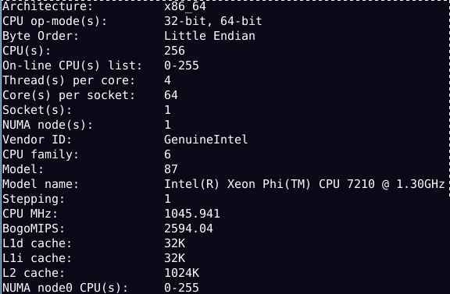
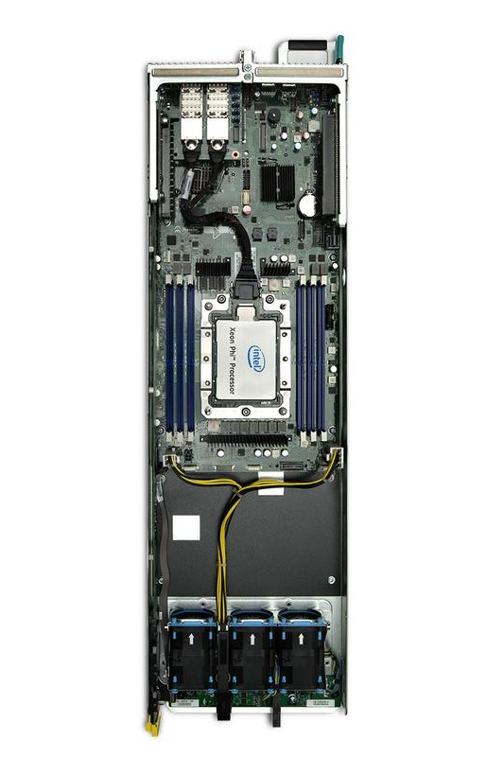
KNL Architecture
Notes:
•Objectives •What are the processor power and memory power?
•What power management abilities are available on Knights Landing?
•What should we use Knights Landing for different applications?
•Method •Benchmarking/stress tests •Empirical analysis

Slide 4
Our Work
Researching various power/energy benchmarks available for KNL
SPEC-OMP SPEC-HPC
PARSEC - Princeton Application Repository for Shared-Memory Computers
Intel Vtune Amplifier XE
TAU-PAPI
NAS Parallel Benchmarks (NPB)
LIKWID Benchmark Suite - RAPL values

Slide 5
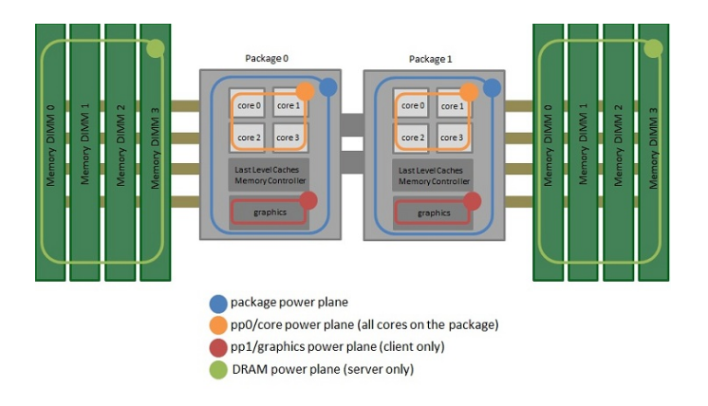
RAPL Values measurements using LIKWID
Intel Xeon Phi KNL family (x200) processors
Counter name | Event name
PWR0 | PWR_PKG_ENERGY | PROCESSOR DIE
PWR1 | PWR_PP0_ENERGY | PROCESSOR CORE SUBSYSTEM
PWR3* | PWR_DRAM_ENERGY | DIRECTLY ATTACHED DRAM

Slide 6
LIKWID TOOL-KIT
Likwid-perfctr
Likwid Group - ENERGY:
Formula
Power = PWR_PKG_ENERGY / time
Power PP0 = PWR_PP0_ENERGY / time
Power DRAM = PWR_DRAM_ENERGY / time

Slide 7
Average CPU Utilization (%)
top -b -n2 -p 1 | fgrep "Cpu(s)" | tail -1 | awk -F'id,' -v prefix="$prefix" '{ split($1, vs, ","); v=vs[length(vs)]; sub("%", "", v); printf "%s%.1f%%\n", prefix, 100 - v }'

Slide 8
NASA Parallel Benchmarks (NPB)
IS - Integer Sort, random memory access
EP - Embarrassingly Parallel
CG - Conjugate Gradient, irregular memory access and communication
MG - Multi-Grid on a sequence of meshes, long- and short-distance communication, memory intensive
FT - discrete 3D fast Fourier Transform, all-to-all communication
BT - Block Tri-diagonal solver
SP - Scalar Penta-diagonal solver
LU - Lower-Upper Gauss-Seidel solver

Slide 9
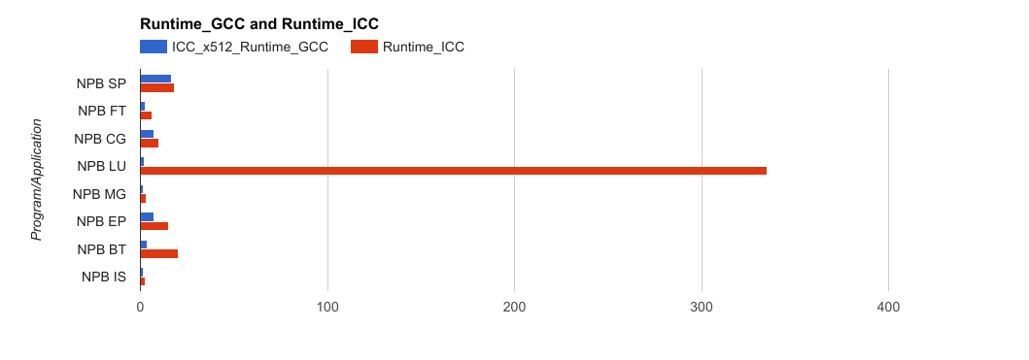
Results - Compiler Comparison
gcc version 4.8.5 20150623 (Red Hat 4.8.5-11)
Using -fopenmp -O3
icc version 17.0.2 (gcc version 4.8.5 compatibility)
Using -qopenmp -O3
icc version 17.0.2 (gcc version 4.8.5 compatibility)
Using -qopenmp -O3 -xmic-avx512
Notes:
Lu linear equation ran iteratively

Slide 10
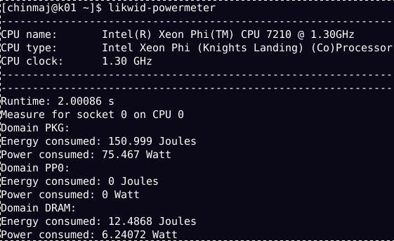
Likwid - Performance monitoring and benchmarking

Slide 11
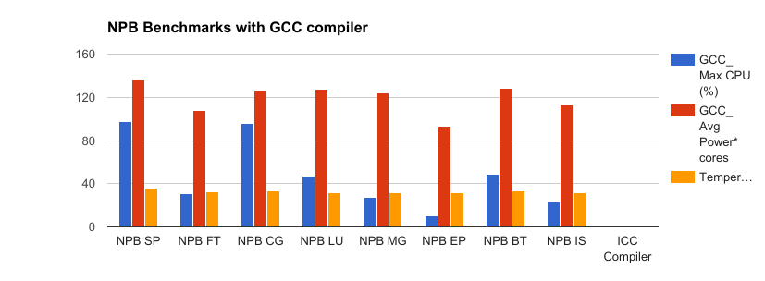
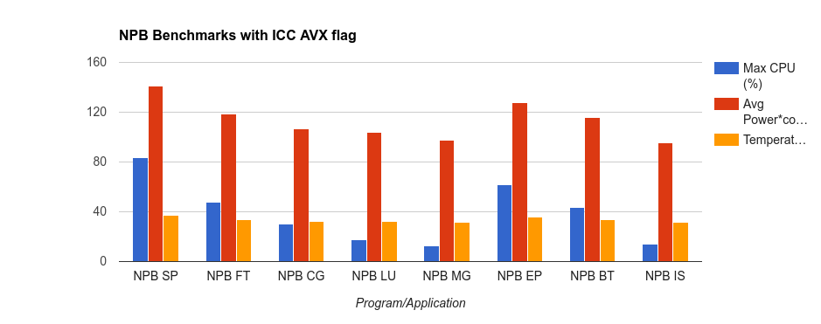
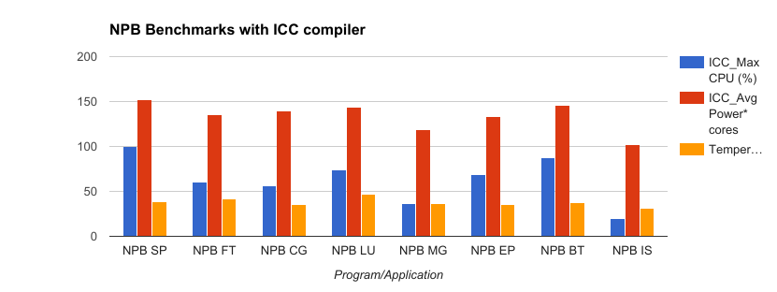
Notes:
Gcc is better

Slide 12
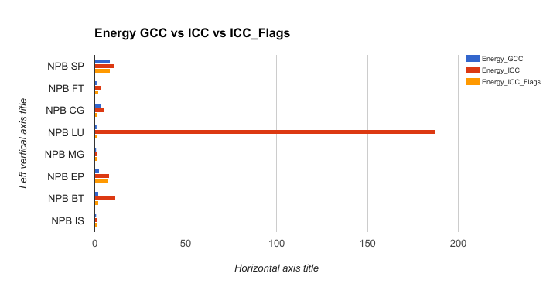
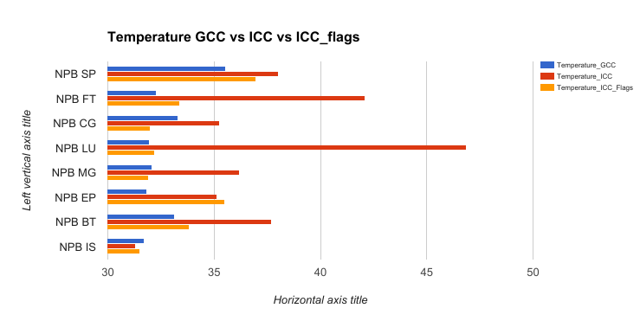

Slide 13
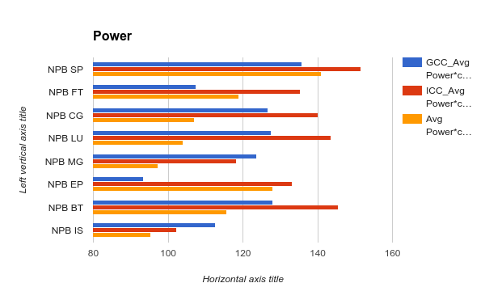
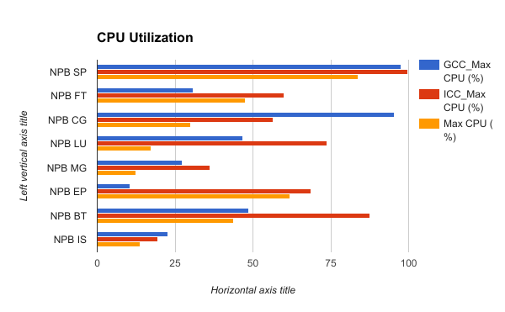

Slide 14
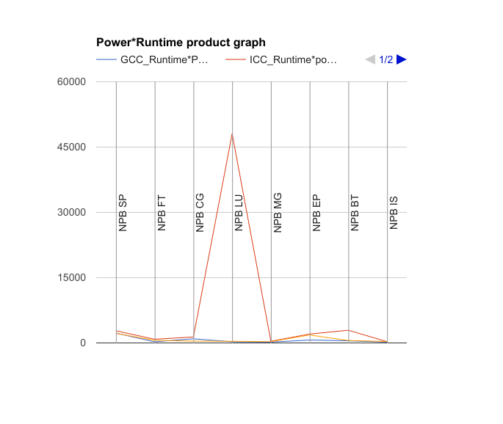

Slide 15

What we learned
Compiler
Compiler Flags
Runtime Environment
Energy consumption is increasing
Power Management

Slide 16


